Slide 1
IRMOS DATA REDUCTION
Preliminary Notes
for a possible pipeline
(M. Robberto, STSCI)

Slide 2
Basic Facts
Data taken on Run 6, night4
KPNO, 2.1m
Ks band, R=3000
Orion Nebula field
Use IDL

Slide 3
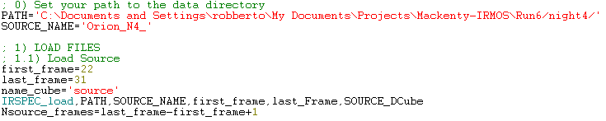
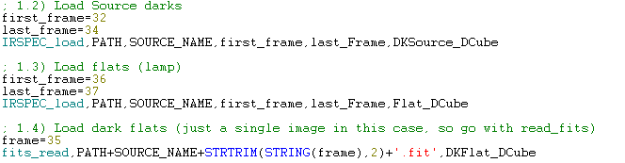
1) Read images
Note: IRSPEC_load is a simple routine to read and store
2d images in 3d data cubes

Slide 4
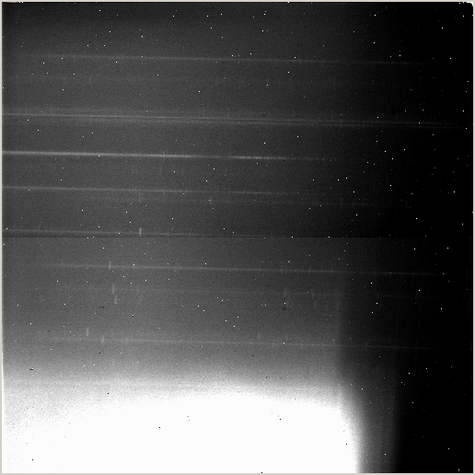
A raw source image
High diffuse thermal
background
Source spectra
Reflection on the
filter holder

Slide 5
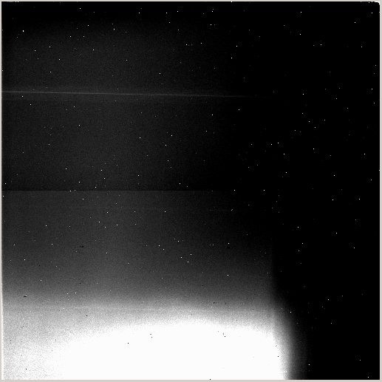
A raw dark frame
DMD off beam
High diffuse thermal
background
Hot emitting mirrors
Reflection on the
filter holder

Slide 6
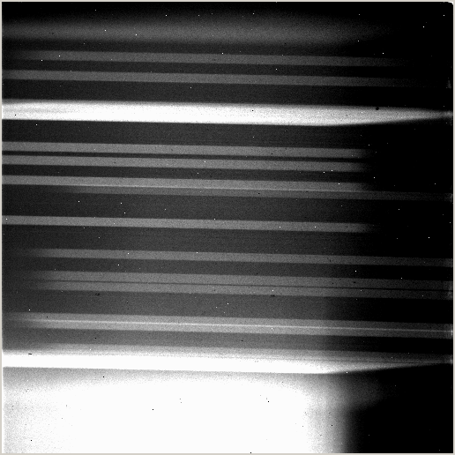
A raw flat field
Tungsten lamp on
DMD on-beam
Grating in
High diffuse thermal
background
Hot emitting mirrors
show bright spectrum

Slide 7
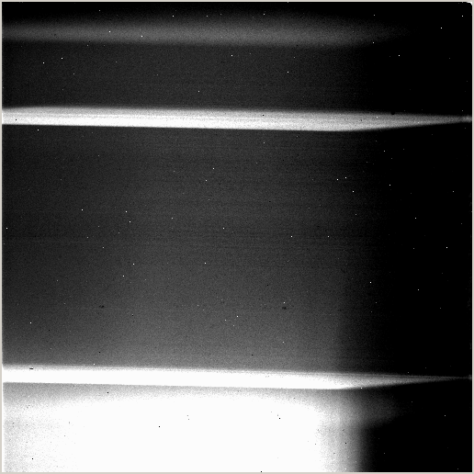
Flat Field dark
Tungsten lamp on
DMD off-beam
Grating in
Hot emitting mirrors
show bright spectrum

Slide 8
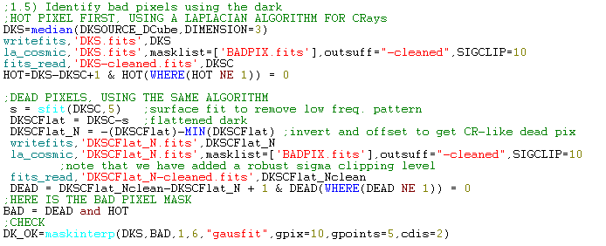
Identify bad (hot) pixels in dark
Notes:
I use a laplacian cosmic ray cleaner to isolate hot pixels and dead pixels in median averaged dark
We shall interpolate on nearby pixels to remove hot pixels

Slide 9

Flat field
combine the flats with a median and subtract their dark
Remove the hot pixels (all cleanings are made before
distorsion correction to avoid blurring the bad pixels)
and/or any tool to remove residual hot pixels,
like this my own routine

Slide 10
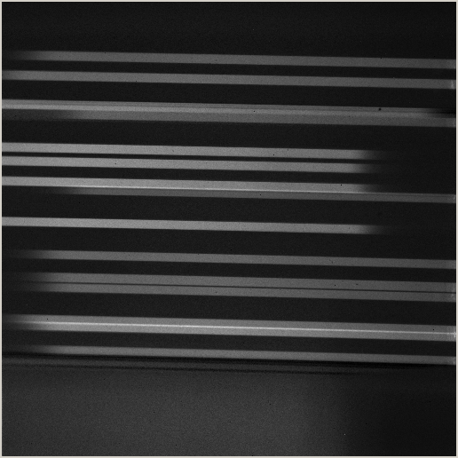
Flat field image
IDL> atv, flat0_c

Slide 11
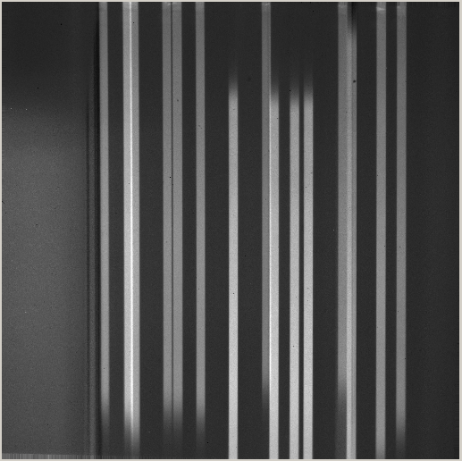
Source identification
Rotate the flat to find the slit position
IDL> atv, flat0_cr

Slide 12


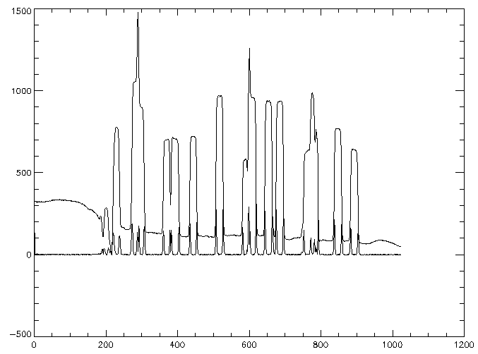
Source identification (cont.)
Output of TARGET_FINDER
X0_target
X1_target

Slide 13
Flat normalization
Each flat has its own normalization factor

Slide 14
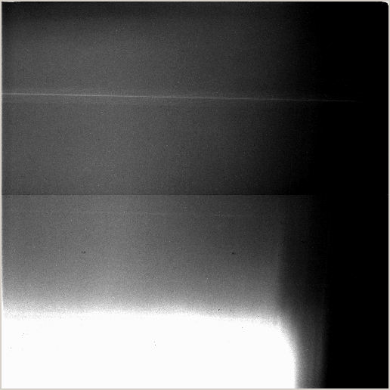
Source dark
IDL> atv,dark0_OK

Slide 15

Apply dark and flat to data cube
We apply dark and flat to each exposure and not to
the coadded exposure for this reason:
The data were taken at the KPNO 2.1m, which has poor
guider, and therefore there is a shift of the source position
between frames.
Alignement will be made on rotated images. Therefore we
clean the cube for hot pixels (e.g. using my routine) and rotate

Slide 16
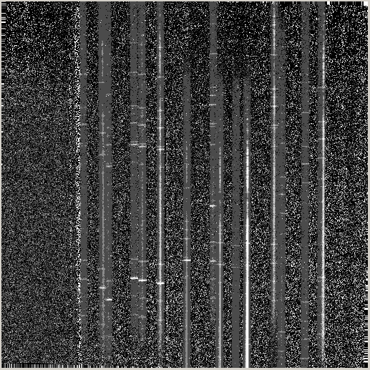
Flat fielded, dark subtracted and rotated data
IDL> Source_DCube_FFcr[*,*,7]

Slide 17
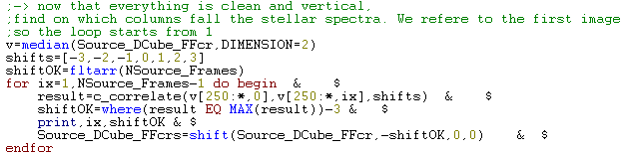
Locate the star position…
… and coadd
(medcombine in this example)

Slide 18
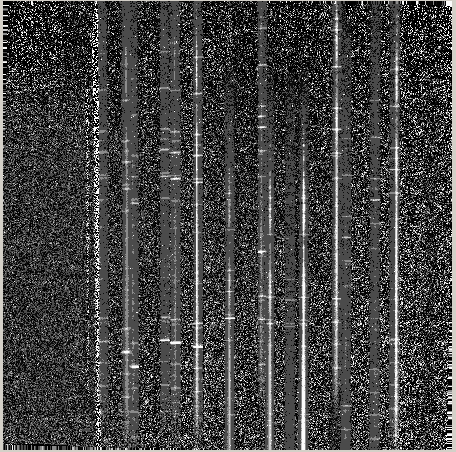
Final image, cleaned
IDL> atv, SOURCE_FFcr

Slide 19
Load the field images

Slide 20
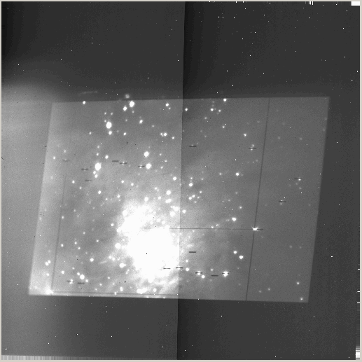
Target acquisition: negative
IDL> atv, field_n

Slide 21
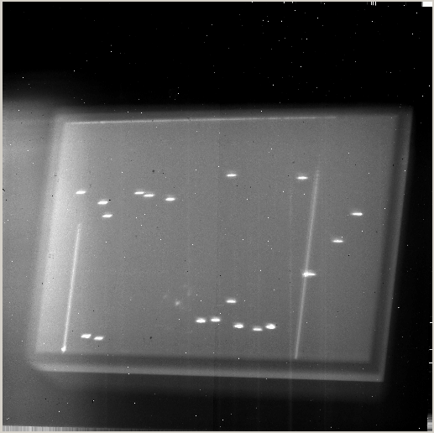
Target acquisition: positive
eliminated
IDL> atv, field_p

Slide 22
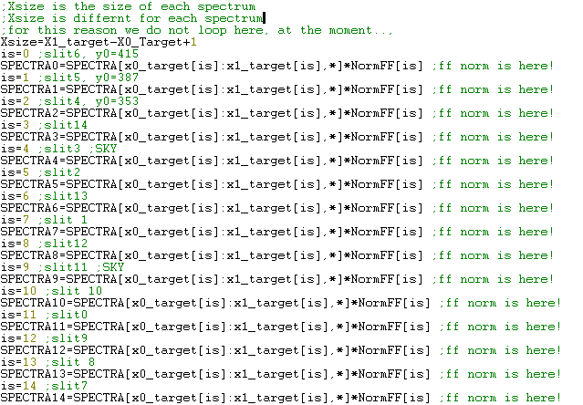
Extract the 15 spectra

Slide 23
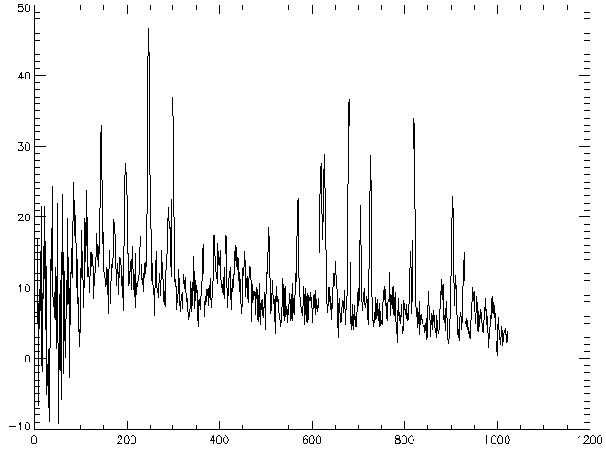
Extract the OH lines from the first spectrum

Slide 24
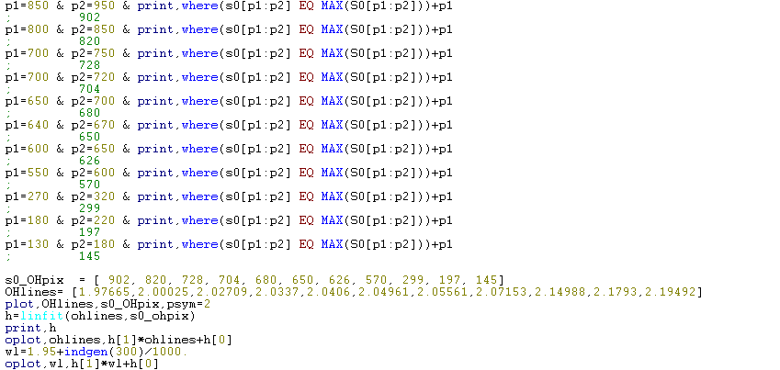
Associate wavelengths to pixels for first spectrum

Slide 25
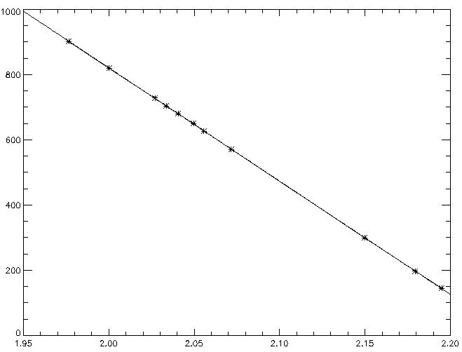
IDL> plot,OHlines,s0_OHpix,psym=2
IDL> oplot, wl,h[1]*wl+h[0]

Slide 26

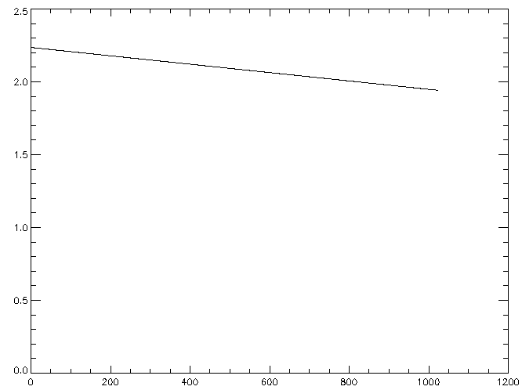
Conversion pixel to wl
(for source 0)
λ (micron)
pixel

Slide 27

To calibrate all other spectra, we use the offset between the slit position and OH lines

Slide 28
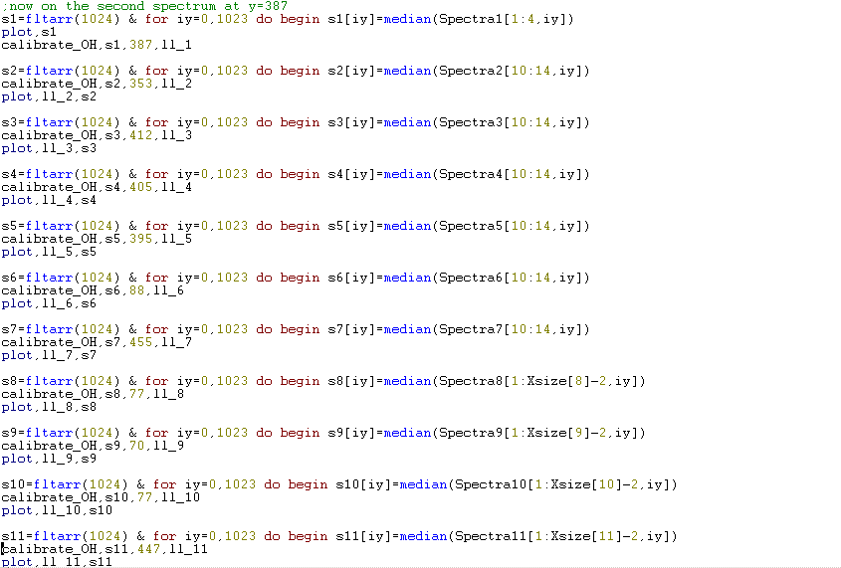

Slide 29
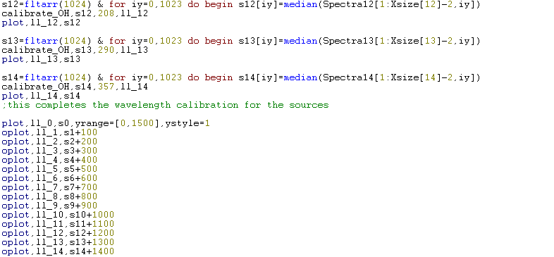

Slide 30
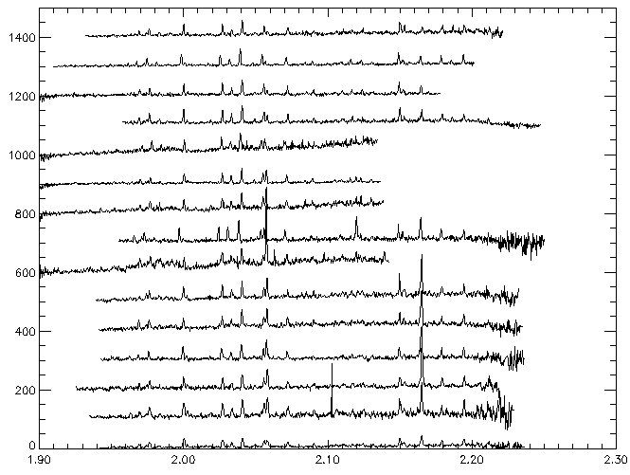
The 15 spectra wl. calibrated

Slide 31

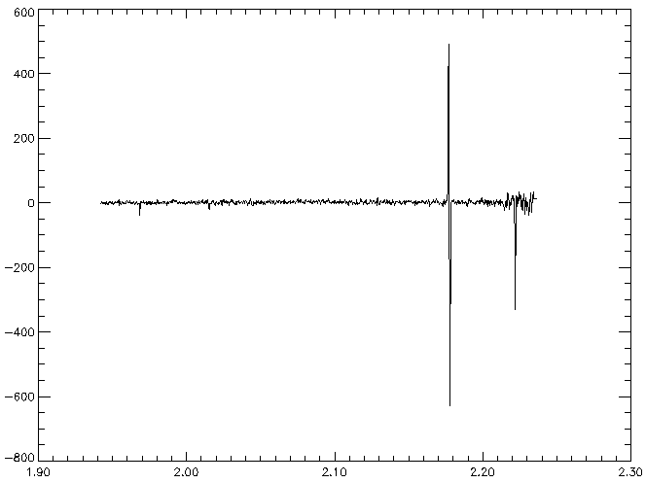
Source 0

Slide 32
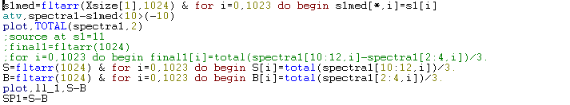
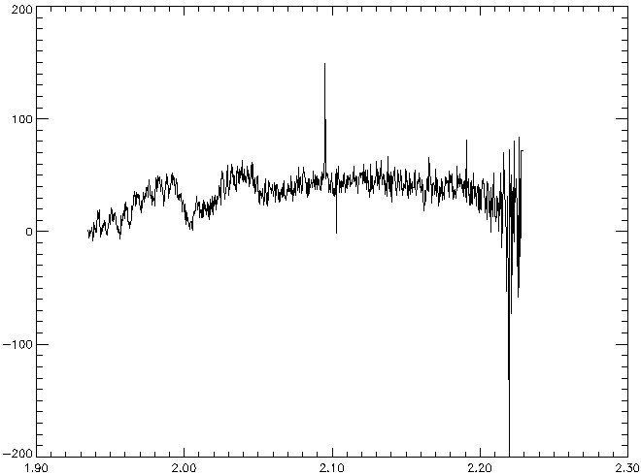
Source 1

Slide 33
… continue

